Slide 1



Noida Institute of Engineering and Technology, Greater Noida
Technical Communication
AASL 0401
Unit: 4
Manuscript Preparation
(Asst. Professor)
Department of English
B. Tech IV Semester

Slide 2
Faculty Profile
Dr. Yusuf Mehdi – Assistant Professor, Dept. of English, NIET, Greater Noida
Mr. Vishal Kumar - Assistant Professor, Dept. of English, NIET, Greater Noida

Slide 3
Evaluation Scheme

Slide 4
Syllabus Unit 5
UNIT-IV | Manuscript Preparation (5 Hours)
Short Report Writing Copy Editing and Referencing Developing writing style- Jargons, Abbreviations Ethical Writing

Slide 5
Content
Introduction
Syllabus
Course Objective/Unit Objective/Course Outcome
CO-PO & PSO Mapping
Manuscript Preparation – Short Report Writing
Copy Editing and Referencing
Developing Writing Style- Jargons, Abbreviations
Ethical Writing
Video Links
Daily Quiz
Weekly assignment
MCQ’s/ Old Question Paper
Expected Questions
Summary
Topic Objective
Reference Books

Slide 6
Course Objective
After completing the course, the students will be able to:
communicate effectively, in clear and correct English, in a style appropriate to the occasion
frame effective short reports
understand the importance of avoiding plagiarism and copying in Manuscript preparation
acknowledge the source of information in accepted referencing styles

Slide 7
Unit Objective
The students will be familiar with the importance and process of manuscript preparation
The students will know how to write short reports
The students will know how to acknowledge sources of information while preparing a manuscript
The students will use appropriate style of referencing

Slide 8
Course Outcome
CO1 Comprehend the fundamental principles of technical communication with special reference to reading.
CO2 Write various kinds of professional correspondence.
CO3 Recognise and produce different kinds of technical documents.
CO4 Apply effective speaking skills to communicate at the workplace.
CO5 Demonstrate their understanding of various ethical concerns in written communication.

Slide 9
Program Outcomes (PO)
PO1: To develop the ability amongst students to apply the principles in solving real world problems.
PO2: To develop the mathematical and analytical skills for making them capable of analyzing the complex real-world problems and can develop/design the effective solutions accordingly.
PO3: To nurture the critical thinking skills to make them able to think out of box.
PO4: To make the students sensitive and responsible about professional and human ethics for the betterment of society.

Slide 10
Program Outcomes (PO)
PO5: To improve the students communication skills to make them sound in presentations.
PO6: To prepare the students for higher studies in computer applications.
PO7: To develop high valued computer professionals
PO8: To make the students capable to adapt with the pace of rapidly growing technologies

Slide 11
Program Outcomes (PO)
PO9: To make them a quick learner and adaptive in nature for their better sustainability in the competitive world.
PO10: To make them respect and follow the standard practices while devising the solution to any problem.
PO11: To enhance their influential, managerial skills, leadership skills, etc.
PO12: To make the students a good citizen.

Slide 12
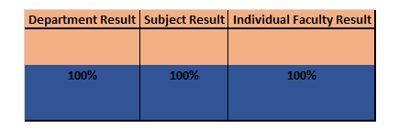
Result Analysis

Slide 13
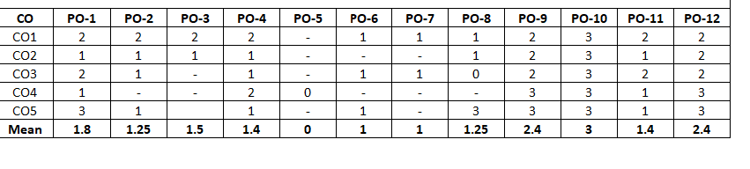
CO-PO Mapping

Slide 14
Noida Institute of Engineering and Technology, Greater Noida
Topic 1
Short Report Writing
Unit: 4
Technical Communication
AASL 0401
Department of English
B. Tech IV Semester

Slide 15
Prerequisites
The student should be familiar with basic writing skills
The student should be familiar with the format of a formal report (Unit 3)

Slide 16
Topic Mapping with Course Outcome
CO5 Demonstrate their understanding of various ethical concerns in written communication
The students will be able to apply their knowledge of manuscript preparation to write effective short reports.
Students will know how to avoid plagiarism in writing and acknowledge the source of information

Slide 17
Introduction
What is a Report ( A Recap)
A written document describing the findings of some individual or group
The act of informing by verbal report
Report is an account of or a statement about something that happened in the past. Etymologically, ‘report’ means to carry back because ‘re’ means back and ‘portare’ means to carry. Thus, report is a description of some event or situation that has already happened.

Slide 18

Business Reports
A business report is a formal communication written for a specific purpose, conveying authentic information to a well-defined audience in a completely impartial and objective manner.
Written in a conventional or usable form, it describes the procedures followed in the collection and examination of data, analyses the facts collected, derives conclusions from them, and gives recommendations, if necessary.

Slide 19
Salient Features of a Report
A formal piece of writing – A report is a formal piece of writing. It is not a document where one expresses his/her ideas and feelings freely. It is essentially written in accordance with certain rules and norms.
A factual account – Every report is a collection of data for the intended readers who will make efficient use of it. The facts contained in a report may be an account of something that has already happened or something latest, an account of any new information, any plan for a course of action etc.
Written with a specific purpose – It originates with a need, desire or purpose. It is written to help the intended readers to keep track of information or to take important decisions or actions.

Slide 20
Contd.
4. Written in an organized manner – Since reports are based on facts, they have an organized structure. While writing a report, a proper planning and presentation of data is quite important.
5. Written for a specific audience – Since, the subject matter of a report is related to the readers, it is always written with kind of audience in mind.
6. Includes only relevant information – A report includes only essential information. Redundant language should be avoided. Only that information should be included which helps readers save their time and make them understand the matter clearly.

Slide 21
Contd.
4. Written in an organized manner – Since reports are based on facts, they have an organized structure. While writing a report, a proper planning and presentation of data is quite important.
5. Written for a specific audience – Since, the subject matter of a report is related to the readers, it is always written with kind of audience in mind.
6. Includes only relevant information – A report includes only essential information. Redundant language should be avoided. Only that information should be included which helps readers save their time and make them understand the matter clearly.

Slide 22
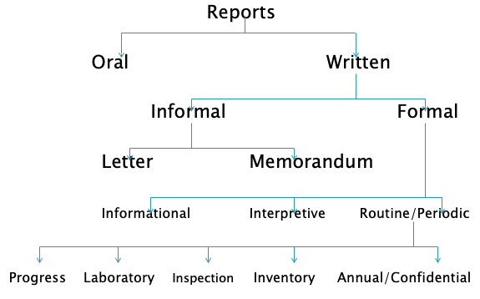
Types of Reports

Slide 23
Oral Reports vs Written Reports
Oral Reports | Written Reports
Spoken | Written
Presented face to face | Not necessarily
Easy for the speaker since preparation is already done and difficult for listener | Easy for the reader to take his/her own time in grasping the facts but difficult for the writer since he/she must gather facts, analyze them, and draw conclusions.
Ephemeral in nature | Permanent record of information
Immediate clarification is possible | In the absence of face-to-face communication, immediate clarification is not possible
Less accurate and reliable | More accurate and reliable
Informal | Formal

Slide 24

Short Reports
A short report is just like any other report but with fewer pages. It should state the key report objectives, summarize the background information, review the alternatives and recommend a way forward. Treat the report as a project – plan for it, then write it in a clear and simple style.

Slide 25
Contd.
PURPOSE:
When a brief written communication is necessary and can do the job for the reader.
For example, a weekly or monthly financial or production report can be handled by a Short Report.
Or a proposal for a simple project or improvement on a process can be written up in a Short Report.
WHAT IS THE FORM?
Can be written as a Letter or as a Memo.
Memo when it is written within the department or company. (Sometimes a letter is OK here.)
Letter when it is written for outside your company.

Slide 26
Contd.
WHAT ARE THE PARTS?
There are usually 4 parts.
Summary
Background (which is optional and not always necessary)
Body (main contents) The content may even include a simple, small chart or diagram (if it contains lots of information, is complex or several pages, then include it in the “attachments” section). When you use HEADINGS and a list . . . remember that after each heading it is more effective to write a short sentence or phrase to INTRODUCE the list.
Recommendation or Conclusion (use either one, depending on the subject/purpose of your report).

Slide 27
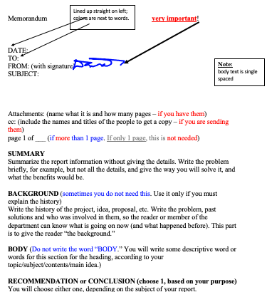
Short Report Format (Memo)

Slide 28
Faculty Video Links, YouTube & NPTEL Video Links and Online Courses Details
https://www.youtube.com/watch?v=TW-1aan4nFs
https://www.youtube.com/watch?v=Sq2SDdz1i8U
https://www.youtube.com/watch?v=Xp2PVO3do34

Slide 29
Daily Quiz
A report or account is an:
a) Informational work b) Technical work c) Professional work d) None of these
2. Report are often used to display the result of:
a) Experiment b) Investigation c) Inquiry d) All of these
3. The length of a short report should be:
a) 13 pages b) 1-2 pages c) 1/5-page d) full page

Slide 30
Daily Quiz (Answers)
A report or account is an:
a) Informational work
2. Report are often used to display the result of:
d) All of these
3. The length of a short report should be: b) 1-2 pages

Slide 31
Weekly Assignment
What is a report?
Discuss the significance of a report.
Bring out the difference between Oral reports and written reports.
Write a short report on a project that you have undertaken for your department.
Write a memo on road safety in Greater Noida, to be presented to the Greater Noida Authority.

Slide 32
MCQ s
Which is not basis for a technical report?
A. Facts B. Tests C. Personal prejudices D. Experiments
2. Shorter report is considered to be as.
A. One to two pages B. Three to five pages C. Four to five pages D. Two paragraph
3. In a technical report which of these must be avoided.
A. Facts B. Logical conclusion C. Objective evaluation D. Subjective evaluation

Slide 33
MCQ s (Answers)
Which is not basis for a technical report?
A. Facts B. Tests C. Personal prejudices D. Experiments
2. Shorter report is considered to be as.
A. One to two pages B. Three to five pages C. Four to five pages D. Two paragraph
3. In a technical report which of these must be avoided.
A. Facts B. Logical conclusion C. Objective evaluation D. Subjective evaluation

Slide 34
Old Question Papers
New course

Slide 35
Expected Questions for University Exam
Q1. What is a Report? What is its significance?
Q2. What is a short report?
Q3. Discuss the salient features of a report.

Slide 36
Summary
Definition of a Report
Difference between Oral and Written reports
Salient features of a report
Types of report
Important parts of a report
Short reports
Format of short reports

Slide 37
Topic Objective
The students know the importance and format of reports.
The students know about difference between oral reports and written reports.
The students can write a short report.

Slide 38
Noida Institute of Engineering and Technology, Greater Noida
Topic 2
Copy Editing and Referencing
Unit: 4
Technical Communication
AASL 0401
(Asst. Professor)
Department of English
B. Tech IV Semester

Slide 39
Prerequisites
The student should be able to communicate in basic English.

Slide 40
Topic Mapping with Course Outcome
CO5 Demonstrate their understanding of various ethical concerns in written communication
To make students understand the importance of communication skills in an ever-changing workplace.
Students will know the features of communication and learn how to use it in their day-to-day interaction.

Slide 41
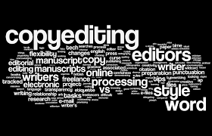
Introduction
Copy Editing is the process of revising written material to improve readability and ensuring that text is free of grammatical and factual errors.
Editing a manuscript, document, text, etc. for publication purpose and making the text free from following errors:
punctuation
spelling
grammatical structure
style

Slide 42
Copy Editing
Copyediting is the process of correcting errors in a text and making it conform to an editorial style, which includes spelling, capitalization, and punctuation.

Slide 43
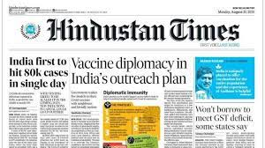
Copy Editing
The Copy
Material for a newspaper article or magazine article
The text as written by the author

Slide 44
Copy Reading
It is also called as “COPY EDITING”.
It is an art of arranging, collecting and selecting the quality and types of news.
The person who does the job is called
“COPYREADER or COPY EDITOR”

Slide 45
Responsibilities of a Copy Editor
To edit grammatical errors (Spellings/Tenses/Subject-Verb Agreement)
To edit errors of fact & Accuracy
To edit verbose copy
To write the headline
To delete opinion or slant libelous statements

Slide 46
Types of Copy Editing
Proofreading: The process of checking grammatical accuracy of written content
Line Editing
Fact-Checking
Rewriting

Slide 47
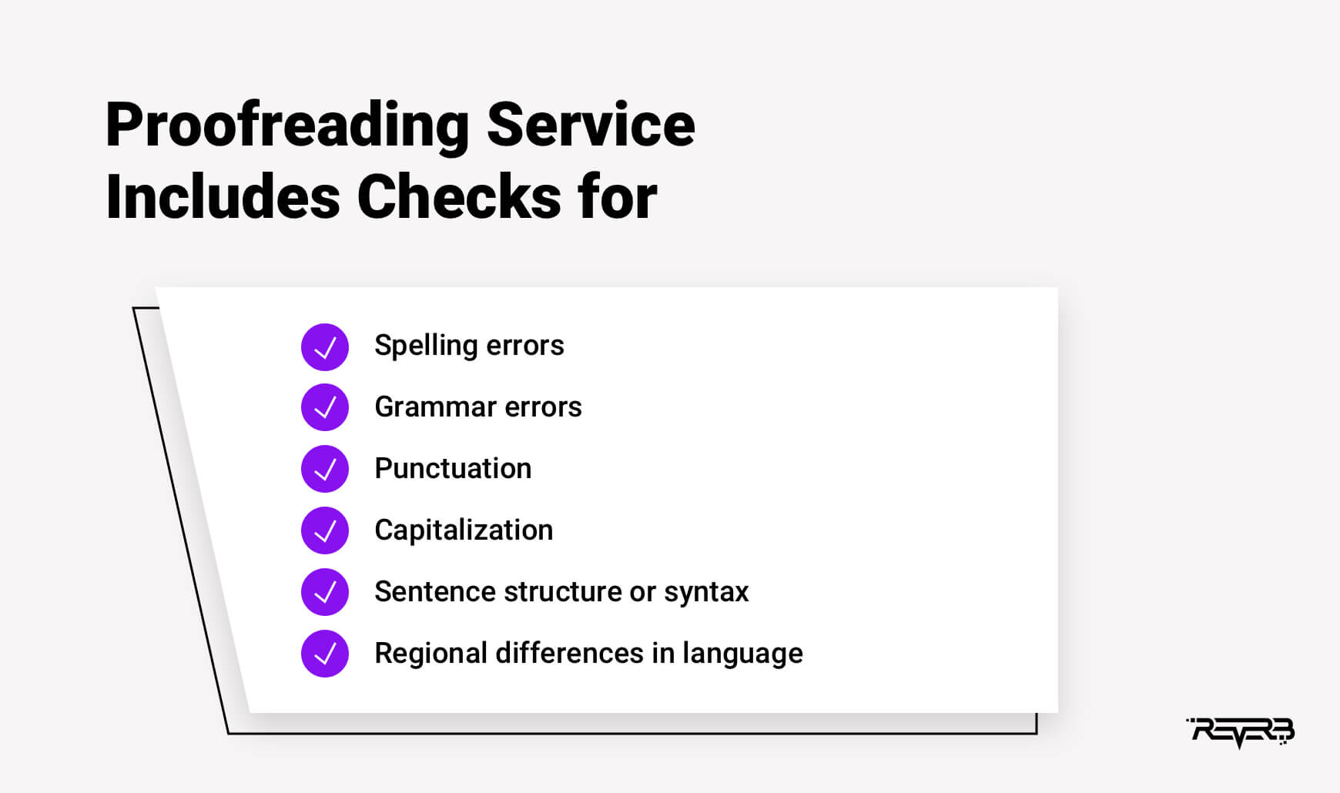
Proofreading

Slide 48
Line Editing
A line edit is focused on the content, style, and language use within the manuscript.
A professional line editor may point out sections that can be improved, parts where the style is inconsistent, issues with pacing, or overuse of certain words or phrases throughout the manuscript.

Slide 49
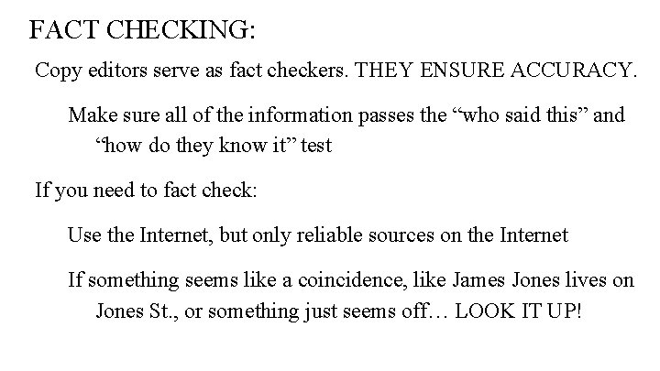
Fact-Checking
Ideally fact-checking should be done before the manuscript reaches the copy-editing stage

Slide 50
5 C’s of Editing
To focus on five hierarchical characteristics of good writing, or the 5 C’s of good academic writing, which include
Clarity
Cogency
Conventionality
Completeness and
Concision

Slide 51
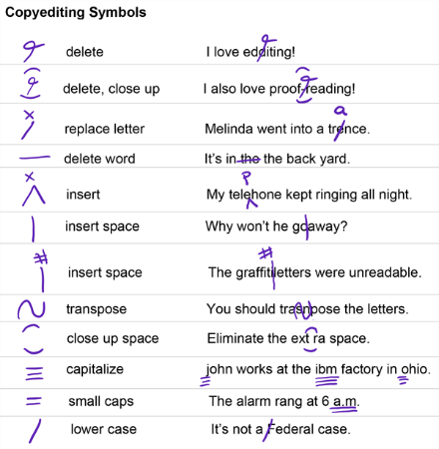
Symbols of Copy Editing

Slide 52
Rewriting in Editing
Although the name can be misleading, a rewrite does not mean that the editor completely rewrites your text.
This term merely refers to a more substantive edit.
When an editor completes a rewrite, he or she substantially rewords or reorganizes the text so it flows better and so it is clearer and more concise.

Slide 53
Objectives of Copy Editing
The objectives of copy-editing include checking for homogeneity in the style of the writing
reorganizing the content for clarity
logical progression
correcting improper grammar
word choice and checking citations
To remove any obstacles between the reader and the author
To find and solve any problems before the book goes to the typesetter
To improve the overall coverage and presentation of a piece of writing

Slide 54

Good editing can transform a mediocre piece of content into something great. Becoming a good editor of your own work takes time and practice.
Become a Good Editor of Your Own Work
Read your text or piece of writing again and again to figure out the errors
Eliminate grammatical errors
Remove uncertain language
Avoid repetitive phrases
Use tools like: Grammarly or Spellchecker

Slide 55
Tips on Editing
Keep an editing checklist
Edit line-by-line
Break up long sentences
Use digital tools
Put yourself in your reader’s shoes
Read your writing out loud
Make paragraphs smaller and sentences shorter
Avoid ambiguity and using excessive jargons

Slide 56
Referencing
What is Referencing?
Referencing is a standardized way of acknowledging the sources of information and ideas that one uses while writing a manuscript, and which allows the sources to be identified.
It is a method used to demonstrate to the readers that the writer has conducted a thorough and appropriate literature search and carried out appropriate reading.
(Source: https://www.slideshare.net/harikafle944/referencing-citation-57924617)

Slide 57
Need for Referencing
Why Referencing?
Referencing is important to avoid plagiarism, to verify quotations and to enable readers to follow up what the writer has written and understand the cited author’s work.
If the works or ideas of other authors are not duly cited, it means copying and plagiarising, which is a cognizable offence.
(Source: https://www.slideshare.net/harikafle944/referencing-citation-57924617)

Slide 58
With all referencing styles, there are two parts to referencing: 1. Citing (In-text citations) 2. Reference List The citation contains only enough information for the reader to find the source in the reference list. Usually, this is the name of the source's author and the year the source was published.
Parts of Referencing

Slide 59
Referencing Styles
Referencing is a formal system: there are rules and standards to follow when formatting citations and references.
The referencing styles are subtly different, and different colleges and departments may ask you to use different styles.

Slide 60
Referencing Styles
Contd.
American Psychological Association (APA)
Modern Language Association (MLA)
Oxford Style
Harvard Style
Chicago Style
IEEE Style

Slide 61
Steps in Referencing
Record the full bibliographic details and relevant page numbers of the source from which information is taken
Punctuation marks and spaces in the reference list and citations are very important
Follow the punctuation and spacing exactly
Insert the citation at the appropriate place in the text of your document
Include a reference list that includes all in-text citations at the end of your document.

Slide 62
What should be put in Reference?
Print and electronic books;
Print and electronic journal articles; Webpages; Emails; DVDs, videos, films, CD-ROMs & audio tape recordings;
Newspapers;
Conference papers;
Papers or data published in a repository;
Pamphlets;
Government reports/White papers
Radio/TV/internet broadcasts
Personal communication;
Interviews (if this is a personal interview, you must always ask permission of the interviewee before using such material); and,
Theses and other unpublished work.

Slide 63
Most common Style - APA
In the technical field, the most common referencing style is APA
The students need to know the style of referencing so that the sources are duly acknowledged.

Slide 64
APA – Reference List Citation
In the technical field today, the APA 7th Ed. is followed.
Entries are listed in alphabetical order at the end of the manuscript/report.
Each entry has four basic parts:
The name of the author
The year of publication
The title
The publisher's name

Slide 65
APA – Reference List
In the technical field today, the APA 7th Ed. is followed.
Entries are listed in alphabetical order at the end of the manuscript/report.
Each entry has four basic parts:
The name of the author
The year of publication
The title
The publisher's name

Slide 66
Examples – APA Style
Book
Smith, J. D. (2009). Research ethics in New Zealand: A student guide. Rata Press.
Edited Book-Chapter
Smith, J. D. (2009). Trends in discourse analysis. In G. Schwartz & U. N. Owen (Eds.), Readings in qualitative research design (pp. 15–59). Rata Press.
Journal Article
Smith, J. D. (2009). Māori voices: Approaches to bilingual research. Journal of Academic Methodologies, 38(3), 17–28.
Webpage
Smith, J. D. (2009). Kindergartens and childcare centres in New Zealand. Ministry of Education. http://www.example.com/thepage.htm

Slide 67
Examples – APA Style
Newspaper Article
Smith, J. D. (2009, January 12). Research awards draw industry attention. Albany Times, p. 22.
Magazine Article
Smith, J. D. (2009, January 12). Tertiary funding models in New Zealand. Tertiary Education Magazine, 21(1), 21–24.
Report
Smith, J. D. (2009). National employment predictions and recommendations(Report No. 122). Rata Press.
(Source: https://owll.massey.ac.nz/referencing/apa-interactive.php)

Slide 68
APA – In-Text Citation
In the technical field today, the APA 7th Ed. is followed.
Entries are listed in alphabetical order at the end of the manuscript/report.
Each entry has four basic parts:
The name of the author
The year of publication
The title
The publisher's name

Slide 69
Faculty Video Links, YouTube & NPTEL Video Links and Online Courses Details
https://www.youtube.com/watch?v=miDnLjP3yL4
https://www.youtube.com/watch?v=D5dOlK-u0VI
https://www.youtube.com/watch?v=wxzmhb7s294&t=1s
https://www.youtube.com/watch?v=0X3iqxWr47s

Slide 70
Daily Quiz
1. A person who edits a copy of a story is called an __________________.
A. Developmental Editor
B. other
C. Editor
D. Content Editor
2. An editor supervises the reporters and improves his reports for _________________.
A. Design
B. Proofreading
C. Captioning photos
D. publication

Slide 71
Daily Quiz
3. The primary concern of the___________ in the organizational chart of his newspaper is, of course, the editorial department.
A. Other
B. copy editor
C. Content Editor
D. Developmental Editor
4. The _____________ specializes in grammar, punctuation, fact-checking, spelling, and formatting.
A. copy editor
B. Content Editor
C. Acquisition Editor
D. Sports Editor

Slide 72
Daily Quiz (Answers)
1. A person who edits a copy of a story is called an __________________.
A. Developmental Editor
B. other
C. Editor
D. Content Editor
2. An editor supervises the reporters and improves his reports for _________________.
A. Design
B. Proofreading
C. Captioning photos
D. publication

Slide 73
Daily Quiz
3. The primary concern of the___________ in the organizational chart of his newspaper is, of course, the editorial department.
A. Other
B. copy editor
C. Content Editor
D. Developmental Editor
4. The _____________ specializes in grammar, punctuation, fact-checking, spelling, and formatting.
A. copy editor
B. Content Editor
C. Acquisition Editor
D. Sports Editor

Slide 74
Weekly Assignment
Q1. Differentiate between Copy editing and Proofreading.
Q2. Briefly discuss the significance of Referencing in writing.
Q3. Pick any five books and make a reference list in the APA style.

Slide 75
MCQ s
1. The objective of citation style manuals is –
Attribution of other’s intellectual work
Attribution of own intellectual work
Attribution of corporate intellectual outcomes
All of these
2. Which citation style is generally used in the technical field?
APA
MLA
IEEE
ABDC
3. APA Style stands for –
American Psychological Association
American Psychological Associates
Association of Psychological of Americans
American Psychologist Association

Slide 76
MCQ s
1. The objective of citation style manuals is –
Attribution of other’s intellectual work
Attribution of own intellectual work
Attribution of corporate intellectual outcomes
All of these
2. Which citation style is generally used in the technical field?
APA
MLA
IEEE
ABDC
3. APA Style stands for –
American Psychological Association
American Psychological Associates
Association of Psychological of Americans
American Psychologist Association

Slide 77
Old Question Papers
New Course

Slide 78
Expected Questions for University Exam
Q1. Define Referencing and its importance.
Q2. What are the important elements of Reference list citations?
Q3. Bring out the basic difference between copy editing and proofreading.

Slide 79
Topic Objective
The students know about the importance and the process of communication
The students know about the Flows of Communication

Slide 80
Summary
A technical communication writing style should be
Concise, Precise, Direct and Well-organized.
Technical communication styles are-
Understanding writing style, Voice and tone, Mechanics
and grammar, Citations and Citation styles
Technical writing style affects the way you present them.

Slide 81
Reference Books
Improve Your Writing ed. V.N. Arora and Laxmi Chandra, Oxford Univ. Press, 2001, New Delhi.
Leech Geoffery Communicative Grammar of English. Pearson Education Harlow, United Kingdom, 1994.
Sethi. J. Course In Phonetics And Spoken English Prentice Hall India Learning Private Limited; 2 edition (1999)
Rebecca Corfield. Preparing The Perfect CV. Kogan Page Publishers, 2009.
Anderson, Paul V. Technical communication. 8th ed. Cengage Learning, 2011.
IELTS 11: General Training with answers. Cambridge English
L. M. Prasad- Principles and Practices of Management, Sultan Chand & Sons, 7th edition, 2007.
Principles of Management, George R. Terry & S.G. Franklin, AITBS, Delhi.

Slide 82
Topic Objective
The students know about the importance of Technical communication and its features

Slide 83
Noida Institute of Engineering and Technology, Greater Noida
Topic 3
Developing writing style – Jargons, Abbreviations
Unit: 5
Technical Communication
AASL 0401
Department of English
B. Tech IV Semester

Slide 84
Prerequisites
The student should be able to communicate in basic English.

Slide 85
Topic Mapping with Course Outcome
CO5 Demonstrate their understanding of various ethical concerns in written communication
The students will be able to apply their knowledge of manuscript preparation to write effective short reports
Students will know how to avoid plagiarism in writing and acknowledge the source of information

Slide 86
Introduction
Writing skills are specific abilities
Writers put their ideas or thoughts into words to form a meaningful and interactive message
Writing skills are important part of communication skills
Good writing skills allows us to communicate our message with clarity and ease

Slide 87
Developing Writing Style
Writers have their own style and purpose
The manner of expressions can be presented by:
Appropriate choices of words
Appropriate sentence structures
Use of literary devices
Use of rhythm
Usage of grammatical harmony &
Other elements of composition

Slide 88
Types of Writing Style
Writing style depends highly on the type of writing that you want to use for the target audience
For example
You might write in a persuasive style while writing an essay
You may likely use narrative style while writing a story
Types of Writing Style:
Narrative Style
Descriptive Style
Expository Style
Persuasive Style

Slide 89
Narrative Style
This type of writing is used when telling a story, it doesn’t matter whether the story is fictional or based on fact
This type of writing is one of the difficult tasks to master but when done correctly, makes very easy for reading
The author needs to get the audience to enter the story through the use of words
Narrative writing usually has a series of characters and is often written in first person narration
The narrative text will also always feature a beginning, middle, and end

Slide 90
Descriptive Style
Descriptive writing involves capturing every detail
The goal is to really immerse the reader in the experience, making them feel like they are there
It allows the author to describe something in a descriptive manner, this could be a person, a place, an object, or a situation
The language in a descriptive piece of writing appeals to the senses with the writer detailing how things look, smell, sound, etc.

Slide 91
Expository Style
Expository writing is often found in textbooks and is always based around facts and information
It is a style of writing which is used for explaining something to the reader
The personal opinions or feelings of the author does not figure in this style of writing
This type of writing can be seen in Direction manuals, recipe books, newspaper articles, or editorial work etc.

Slide 92
Persuasive Style
Persuasive writing is used as a way of convincing the audience of something & this could be
an idea
an opinion
This type of writing will include the author’s opinion on the topic
When writing in this style, the author should have a good knowledge of the opposing opinion in order to build a case against it
You might see this type of writing in a proposal, an essay or a cover letter

Slide 93
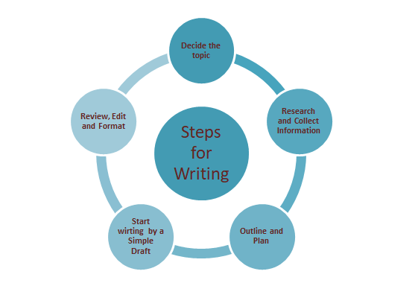
Steps for Writing

Slide 94
Various Types of Writing
Besides the four main types of writing, there are four further types of writing
Objective writing: In this is a type of writing author backs up with data or facts and does not express personal opinions
Subjective writing: In this type of writing the author expresses personal opinions and thoughts
Creative writing: In this type of writing the author uses his imagination and creates a scenario
Review writing: In this form of writing the features of a product, item, place, etc. are described

Slide 95
Planning
In writing reports, essays, emails, or any other material the pre-writing strategy is called the planning stage
Planning writing strategy needs:
To identity the audience
To know the purpose
A message to convey

Slide 96
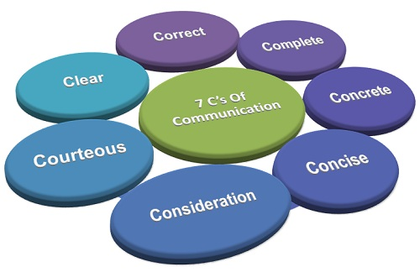
7 C’s of Effective Communication
Image referencing: Financial Yard

Slide 97
Abbreviations
Words that are formed from the initials of several words
ASAP: As Soon As Possible
CEO: Chief Executive Officer
WHO- World Health Organisation
CNG- Compressed Natural Gas

Slide 98
Acronym
An abbreviation formed from the initial letters of other words and pronounced as a word (e.g., NASA).
RADAR (Radio Detection And Ranging)
LASER (Light Amplification by the Stimulated Emission of Radiation)
SCUBA (Self-contained Underwater Breathing Apparatus)
UNICEF ( United Nations International Children’s Emergency Fund)
UNESCO (United Nations Educational Scientific and Cultural Organization)
Is NOIDA an acronym?

Slide 99
Jargons
Words or expressions that are used by a particular profession or group of people, and are difficult for others to understand e.g.
Sports Jargons- rookie, huddle, hat-trick, etc.
Chat Jargons- ASAP, lol, msg, etc.
Computer Jargons- cache, CPU, cookie, crash, etc.

Slide 100
Faculty Video Links, YouTube & NPTEL Video Links and Online Courses Details
https://www.youtube.com/watch?v=b4GnUdkEAWo
https://nptel.ac.in/courses/109/107/109107172/
https://www.youtube.com/watch?v=I9wygIVAxqg
https://www.youtube.com/watch?v=cqHPhH2bFWM

Slide 101
Daily Quiz
The types of writing style is/are
Narrative B. Descriptive C. Persuasive Style D. All of these
What type of writing tells a story with a beginning, middle and end?
Narrative B. Expository C. Descriptive D. None of these
What type of essay gives facts, explains, ideas, directions or terms?
Descriptive B. Narrative C. Expository D. Persuasive
________is not one of the 7 C’s of effective communication skills.
Conciseness B. Correct C. Character D. Clarity

Slide 102
Daily Quiz: Answers
The types of writing style is/are
Narrative B. Descriptive C. Persuasive Style D. All of these
What type of writing tells a story with a beginning, middle and end?
Narrative B. Expository C. Descriptive D. None of these
What type of essay gives facts, explains, ideas, directions or terms?
Descriptive B. Narrative C. Expository D. Persuasive
________is not one of the 7 C’s of effective communication skills.
Conciseness B. Correct C. Character D. Clarity

Slide 103
Weekly Assignment
What is writing style? What are the various types of writing styles? Discuss any one writing style.
Write a paragraph to demonstrate any one of these writing styles:
Narrative Style, Descriptive Style, Expository Style, Persuasive Style
Discuss the importance of writing style and its process.
What is an abbreviation? Support with few examples.
What is a jargon? Support with few examples.
What is the difference between an acronym and an abbreviation?

Slide 104
MCQ s
Special words or expressions that are used by a particular profession or group is
Topic B. Jargon C. Conversation D. specific style
Which one of these is not a part of style?
Tone B. Theme C. Word choice D. Language
What is expository writing?
Writing style in which you describe B. Writing style in which you inform
Writing style in you educate D. Writing style in which you tell a narrative
As a writer, what should you avoid?
Clarity of thoughts B. Abstract language & over explanation
C. Developing points D. Concise statements

Slide 105
MCQ s: Answers
Special words or expressions that are used by a particular profession or group is
Topic B. Jargon C. Conversation D. specific style
Which one of these is not a part of style?
Tone B. Theme C. Word choice D. Language
What is expository writing?
Writing style in which you describe B. Writing style in which you inform
Writing style in you educate D. Writing style in which you tell a narrative
As a writer, what should you avoid?
Clarity of thoughts B. Abstract language & over explanation
C. Developing points D. Concise statements

Slide 106
Old Question Papers
No questions were asked from this topic
It’s a new topic

Slide 107
Expected Questions for University Exam
What are the various types of writing style? Write a paragraph in the persuasive style.
What is expository writing style? Discuss.
What is the importance of effective writing? What are the various type of writing styles?
What are jargons? Give ten examples of jargons used in different professions.

Slide 108
Topic Objective
The students know about the importance and the process of writing style
The students know about the 7 C’s of Communication
The students know about the importance of effective writing and its features

Slide 109
Summary
Writing styles help to express thoughts of every individual differently
It helps to establish a written communication by the various techniques of writing style
A technical communication writing style should be
Concise, Precise, Direct and Well-organized.
Technical communication styles are-
Understanding writing style, Voice and tone, Mechanics
and grammar, Citations and Citation styles

Slide 110
Reference Books
Improve Your Writing ed. V.N. Arora and Laxmi Chandra, Oxford Univ. Press, 2001, New Delhi.
Leech Geoffery Communicative Grammar of English. Pearson Education Harlow, United Kingdom, 1994.
Sethi. J. Course In Phonetics And Spoken English Prentice Hall India Learning Private Limited; 2 edition (1999)
Rebecca Corfield. Preparing The Perfect CV. Kogan Page Publishers, 2009.
Anderson, Paul V. Technical communication. 8th ed. Cengage Learning, 2011.
IELTS 11: General Training with answers. Cambridge English
L. M. Prasad- Principles and Practices of Management, Sultan Chand & Sons, 7th edition, 2007.
Principles of Management, George R. Terry & S.G. Franklin, AITBS, Delhi.

Slide 111
Noida Institute of Engineering and Technology, Greater Noida
Topic 4
Ethical Writing
Unit: 5
Technical Communication
AASL 0401
Department of English
B. Tech IV Semester

Slide 112
Prerequisites
The student should be familiar with basic writing skills

Slide 113
Topic Mapping with Course Outcome
CO5 Demonstrate their understanding of various ethical concerns in written communication
Students will be able to know how to practice ethical writing
Students will be able to avoid plagiarism in writing

Slide 114
What is Ethical Writing?
A writing that clearly indicates (via documentation) where source material has been incorporated into one’s own writing.
Using correct and authentic data.
It acknowledges a range of perspectives on an issue.
Writing with a level of inclusion, respect, and acknowledgement of diversity.
The importance of ethical writing, then, is based not only upon the avoidance of plagiarism, but also avoiding the weaknesses of bias and exclusive language (sexist, racist, homophobic, etc.) This strengthens the credibility and persuasiveness of the writer’s argument.

Slide 115
Citing Sources
Cite sources properly, using the most recent documentation style sheet/manual available.
Cite any and all ideas that are “borrowed” (anything that did not originate with you).
Cite BOTH paraphrases AND direct quotes.

Slide 116


Plagiarism
Many people think of plagiarism as copying another's work or borrowing someone else's original ideas. But terms like "copying" and "borrowing" can disguise the seriousness of the offense

Slide 117
What is ‘Plagiarism?’
According to the Merriam-Webster online dictionary, to "plagiarize" means:
to steal and pass off (the ideas or words of another) as one's own
to use (another's production) without crediting the source
to commit literary theft
to present as new and original an idea or product derived from an existing source

Slide 118
What is considered Plagiarized?
turning in someone else's work as your own
copying words or ideas from someone else without giving credit
failing to put a quotation in quotation marks
giving incorrect information about the source of a quotation
changing words but copying the sentence structure of a source without giving credit
copying so many words or ideas from a source that it makes up the majority of your work, whether you give credit or not
(Source: https://www.plagiarism.org/article/what-is-plagiarism)

Slide 119
Ways of Plagiarizing
Direct Copying: It is directly copying the ideas, messages, texts, projects etc. of others and labelling as your own.
Paraphrasing: It is changing the language of the text or others and labelling as yours.
Word Switching: Plagiarism where the writer changes a few words in the original text of another.
Self-Plagiarism: It is any attempt to take any of your own previously published text, papers, or research results and make it appear brand new.

Slide 120
Plagiarism – An Offence
Plagiarism is governed by Section 57 and Section 63 and Section 63 (a) of Copyright Act, 1957.
As per Section 57 of the Act, provide authors the right (special right)
to claim authorship of their work
to detain or claim damages in respect of any modification, distortion, mutilation, or other act related to the said work which is done before the expiration of the term of copyright if such act would be damaging to his honour or reputation
Source: https://www.nrilegalservices.com/laws-relating-to-plagiarism-in-india/

Slide 121
Plagiarism – An Offence
The Section 63 of the Act states punishment for the offence of breach of rights convened under this Act.
The offender shall be punishable with imprisonment. The term for the offence may vary from six months to three years. The lawbreaker may have to compensate in terms of money i.e. fine which may range from fifty thousand rupees to two lakh rupees. Or both imprisonment and fine.
Where the violation of the rights was not made for gain in the way of business or trade, the court may for special reasons (stated in the judgment) carry out a sentence of imprisonment of less than six months or fine of less than fifty thousand rupees.

Slide 122
Plagiarism – An Offence
The Section 63(a) of the Act states punishment for the offence of breach of rights convened under this Act for the second time.
The offender who commits the offence for the second time (again) will be punishable by imprisonment for the term that may vary from one year to three years and with fine varying from one lakh to two lakhs.
Where the violation of the rights for the second time was not made for gain in the way of business or trade, the court may for special reasons (stated in the judgment) carry out a sentence of imprisonment of less than one year or fine of less than one lakh rupees.

Slide 123
Faculty Video Links, YouTube & NPTEL Video Links and Online Courses Details
https://www.youtube.com/watch?v=vcTfcefoC34
https://www.youtube.com/watch?v=nRExogs31_g
https://www.youtube.com/watch?v=Bxn6F6Xpfco

Slide 124
Daily Quiz
The act of presenting someone else’s work or idea as own is considered as
Plagiarism
Academic dishonesty
Wrongful appropriation
All of these
2. Plagiarism where the writer changes a few words in the original text of another is known as
Direct copying
Word switch
Paraphrasing
None of these

Slide 125
Daily Quiz
3. Can multiple submissions of work be treated as plagiarism?
Yes
No
4. A ____________ is placed within the text and includes the authors’ last names and the publication year. A ___________ is placed at the end of a paper and includes information on the authors, year, the title of the source, and publication data to prevent plagiarism and give proper citation to work referred.
quotation; citation
reference list; quotation
Citation; reference list
reference list; citation

Slide 126
Daily Quiz (Answers)
The act of presenting someone else’s work or idea as own is considered as
Plagiarism
Academic dishonesty
Wrongful appropriation
All of these
2. Plagiarism where the writer changes a few words in the original text of another is known as
Direct copying
Word switch
Paraphrasing
None of these

Slide 127
Daily Quiz (Answers)
3. Can multiple submissions of work be treated as plagiarism?
Yes
No
4. A ____________ is placed within the text and includes the authors’ last names and the publication year. A ___________ is placed at the end of a paper and includes information on the authors, year, the title of the source, and publication data to prevent plagiarism and give proper citation to work referred.
quotation; citation
reference list; quotation
Citation; reference list
reference list; citation

Slide 128
Weekly Assignment
Why is it important to maintain ethics in writing?
What is Plagiarism? Explain different types of plagiarism.

Slide 129
MCQ s
1. What are the common forms of plagiarism?
Direct copying
Word switch
Self-plagiarism
All of these
2. What are the common reasons for plagiarism in student assignments?
Academic Pressure
Poor Writing Skills
Ignorance about citation form and style
All of these
3. What are the different ways to avoid plagiarism in academic writing?
Providing references
Citing the original author
Quoting the exact phrase
All of these

Slide 130
MCQ s (Answers)
1. What are the common forms of plagiarism?
Direct copying
Word switch
Self-plagiarism
All of these
2. What are the common reasons for plagiarism in student assignments?
Academic Pressure
Poor Writing Skills
Ignorance about citation form and style
All of these
3. What are the different ways to avoid plagiarism in academic writing?
Providing references
Citing the original author
Quoting the exact phrase
All of these

Slide 131
Old Question Papers
New Course

Slide 132
Expected Questions for University Exam
Discuss the importance of Ethics in writing.
Define Plagiarism.
What are the different ways of plagiarizing?

Slide 133
Summary
Defining Ethics in writing.
Importance of following ethics in writing.
Plagiarism – Definition
Types of Plagiarism in Academic Writing.
Ways to avoid Plagiarism.

Slide 134
Topic Objective
Students now understand the importance of following ethics while writing a manuscript
Students know how to avoid plagiarism

Slide 135
Thank You

